Slide 1



A Bluetooth navigation app

Slide 2
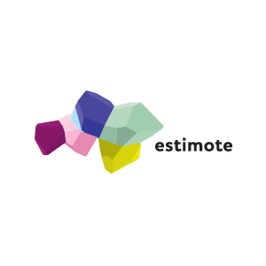
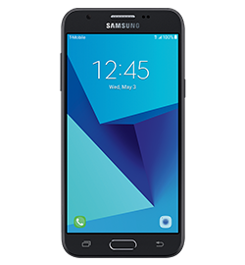

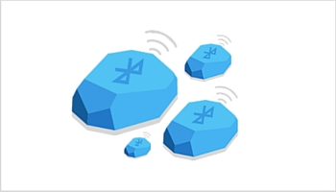
How do they work
Estimote Proximity Beacons are Bluetooth devices that are used to broadcast Bluetooth signals, allowing your smartphone to receive.
These beacons will be placed on a room, which tells you which room the person is at (based on the beacon’s ID).

Slide 3



Target Audiences
Anyone
People who are visually impaired
Text-to-speech and vice-versa
Schools
Shopping centres
Exhibition Halls

Slide 4
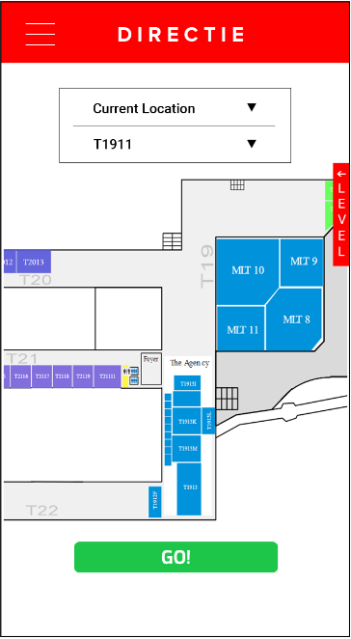
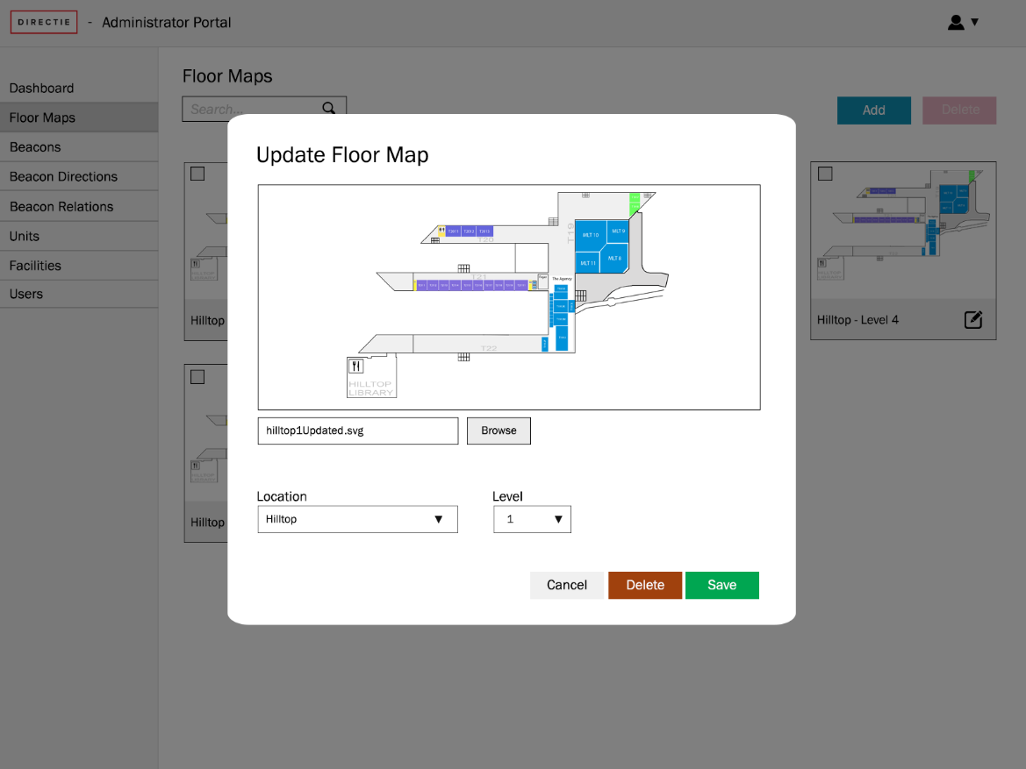
Features of our Application
Front End
Back End

Slide 5
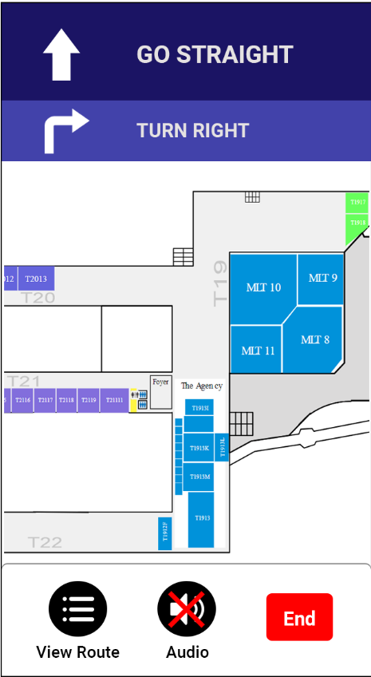
Front End Features
Obtain current location
Navigating from one room to another
Text-to-speech
For every direction, it will be read out to the user.
E.g. turn right
Speech-to-text
Set of commands that require user to speak
E.g. I want to go from ___ to ___
Viewing the map
Floor plan for each level

Slide 6
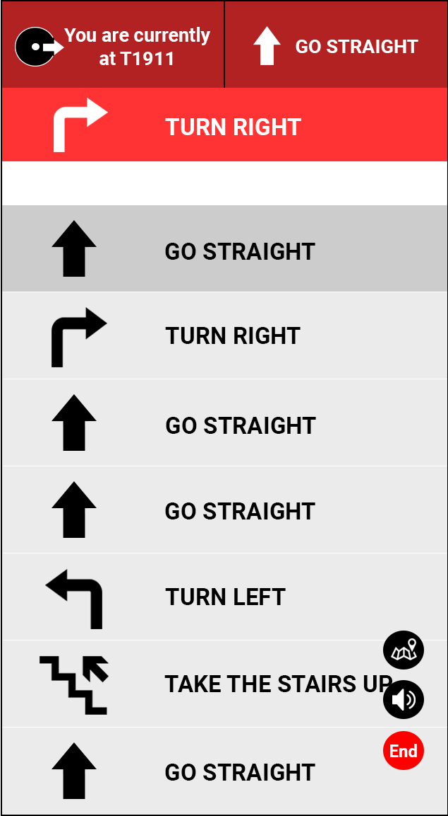
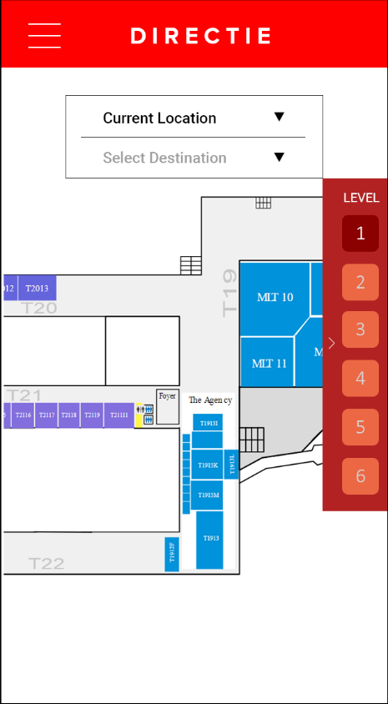
Front End Drafts
Directions given when viewing the route
Floor Plan

Slide 7
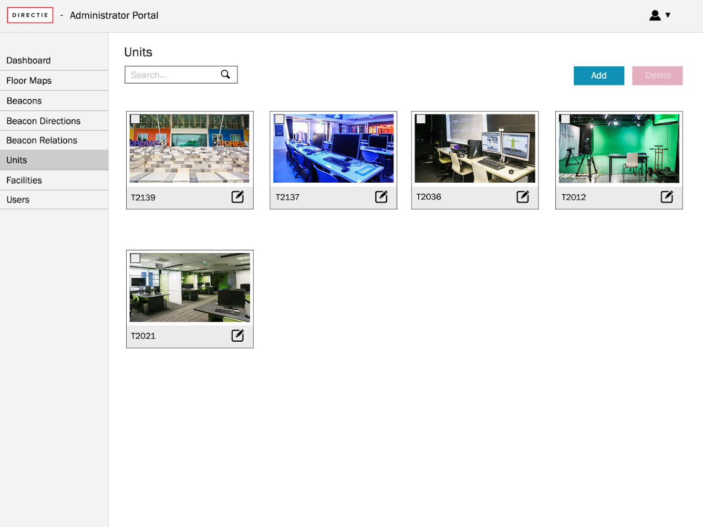
Back End Features
Manage Floor Maps
Manage Facilities
Manage Units
Manage Beacons
Manage Users

Slide 8
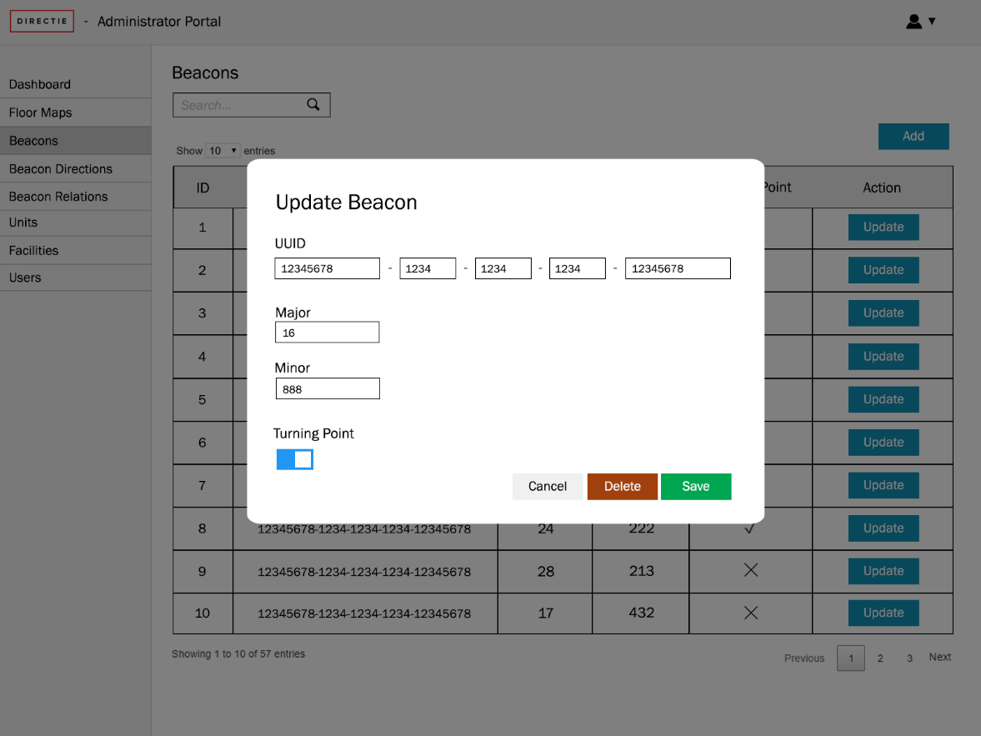
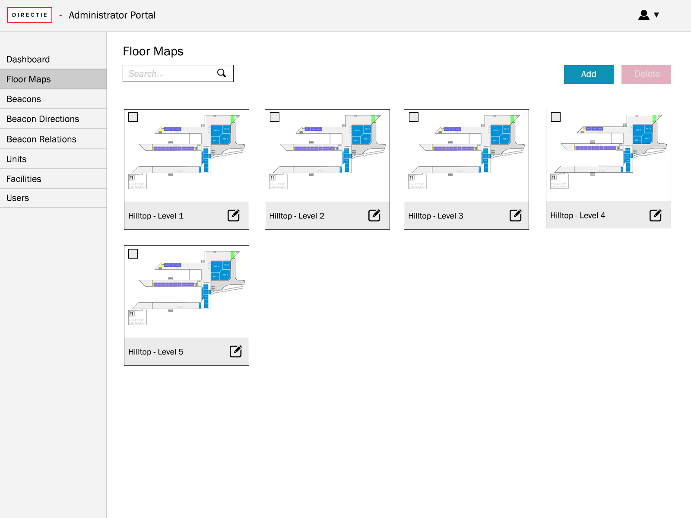
Back End Drafts
Updating a Beacon’s Information
Viewing floor plan

Slide 9
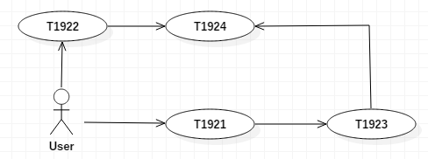
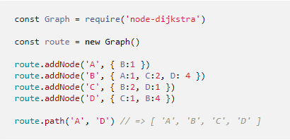
Implementation – Shortest Path
If there are two paths to get to the destination,
we can use a plugin(or package) to determine the shortest path.

Slide 10
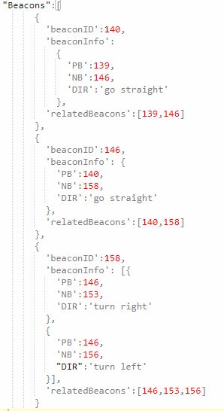
Implementation – Direction
For each beacon, information such as the nearby beacons, previous/next beacons and their direction are stored.

Slide 11
Why choose us?
Easy to setup, flexible
Can be used everywhere, without relying GPS
Provide help for the visually impaired users

